Slide 1
Curriculum Learning for Heterogeneous Star Network Embedding via Deep Reinforcement Learning
Source : WSDM 2018
Advisor : JIA-LING KOH
Speaker : YI-CHENG HUNG
Date:2018/04/24

Slide 2
Outline
Introduction
Method
Experiment
Conclusion

Slide 3
Outline
Introduction
Method
Experiment
Conclusion

Slide 4
Introduction-motivation
訓練模型
預測類型:
奇幻類型
Embedding vector
Notes:
NN的INPUT是embedding vector，要如何訓練一個足夠代表input的embedding vector?

Slide 5
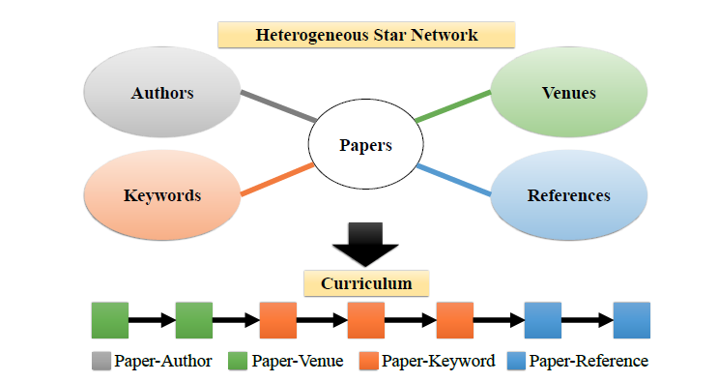
Introduction-goal
如何得知最好的修課順序?
Goal:在考試時拿到最好的成績
修課順序

Slide 6
Outline
Introduction
Method
Experiment
Conclusion

Slide 7
Method-framework
假設已經一經上過(A,A,B,B,C)的課程了
如何決定下一次的課程?

Slide 8
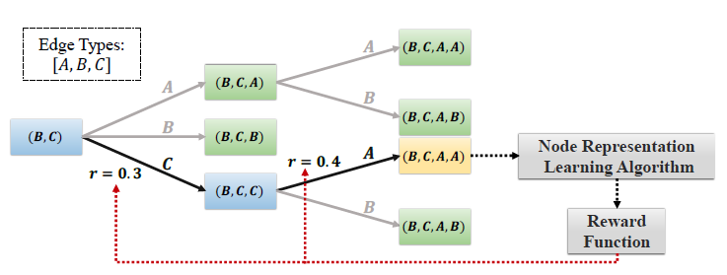
Method-Planning Module

Slide 9
Q-Learn
η是學習率，決定此次誤差有多少被學習
Γ是折扣率，決定未來策略的比重
現實
估計

Slide 10
Method-framework

Slide 11
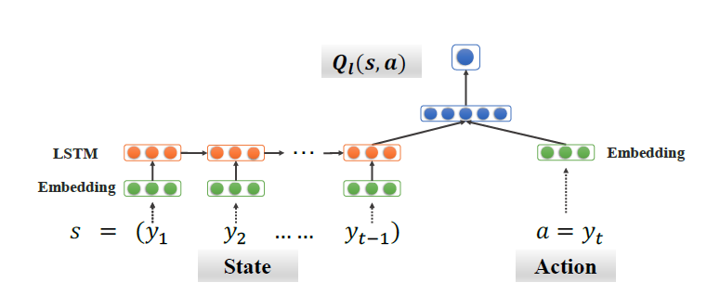
Method-Learning Module

Slide 12
Method-Integrating

Slide 13
Outline
Introduction
Method
Experiment
Conclusion

Slide 14
Experiment-dataset
多標籤類型會進行排除

Slide 15
Quantitative results in the unsupervised setting

Slide 16
Quantitative results in the semi-supervised setting

Slide 17
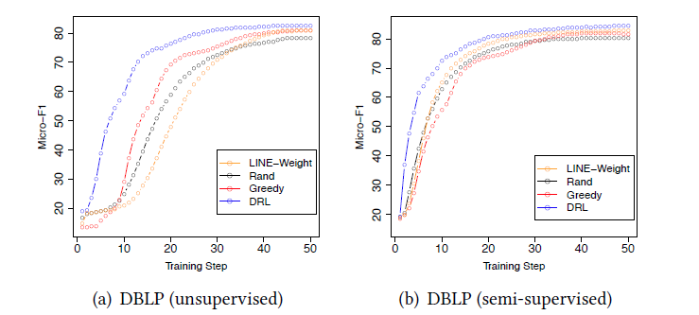
Performance w.r.t. training steps on the DBLP dataset.

Slide 18
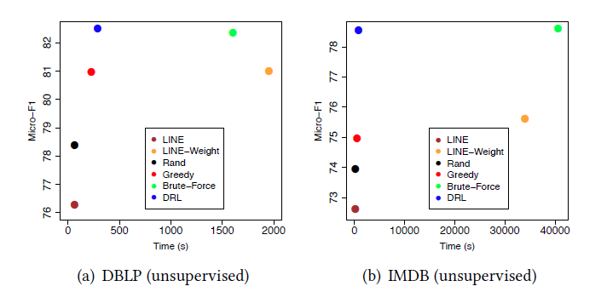
Performance v.s. the running time.

Slide 19
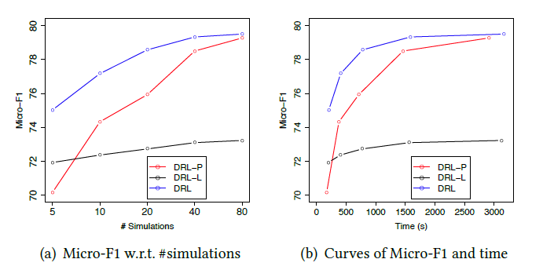
Performance w.r.t. #simulations on the IMDB dataset.

Slide 20
Outline
Introduction
Method
Experiment
Conclusion

Slide 21
Conclusion
Proposed a deep reinforcement learning based approach
Integrates the learning and planning strategies
Experimental results proved the effectiveness and efficiency of our approach.

